Slide 1
Census Dot Maps
Students Name
Institutional Affiliation

Slide 2
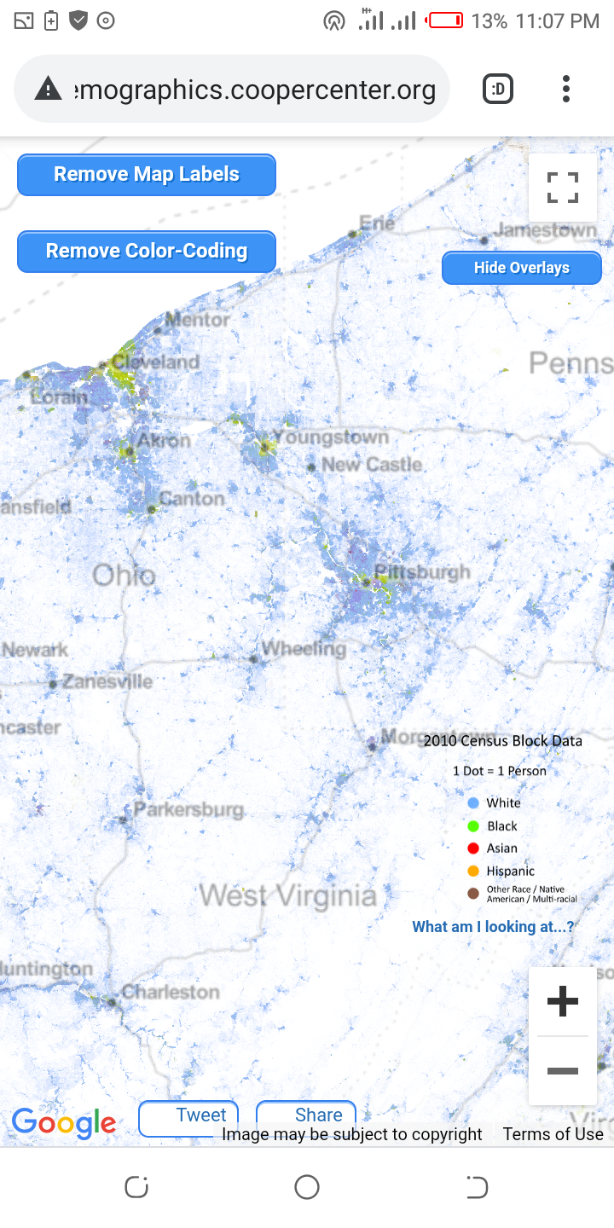
Virginia
Land area 39490.1 square miles
Population 8001024
It’s ethnically diverse metropolis.
Density 202.6 people per square mile.
Borders Columbia, Kentucky, Maryland.
Notes:
Virginia state has a population of 8001024. It is ethnically metropolis with population density of 202.6 persons per square mile

Slide 3
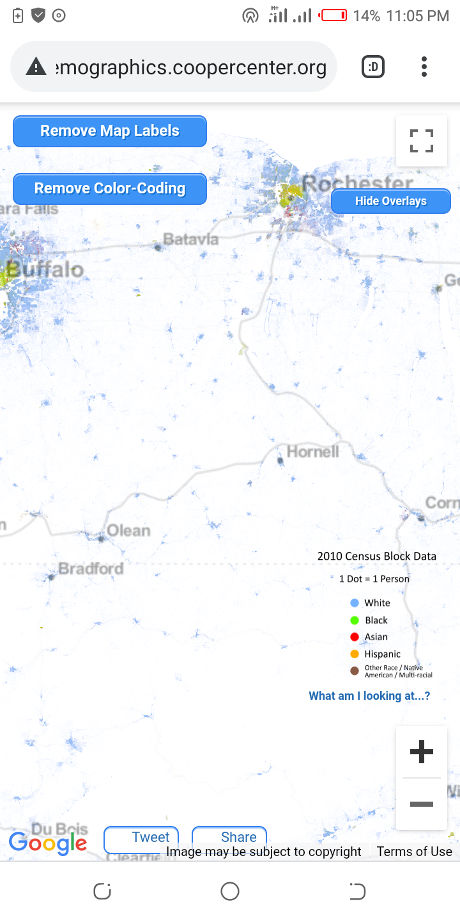
Maryland
Population of 6065440
Land area 12407 square miles
488.8 persons per square miles.
Borders Pennsylvania, Virginia, Columbia, Delaware and west Virginia.
Notes:
Maryland has a land area of 12407 squire miles with population density of 488.8 persons per squire miles.
It has a population of 6065440

Slide 4
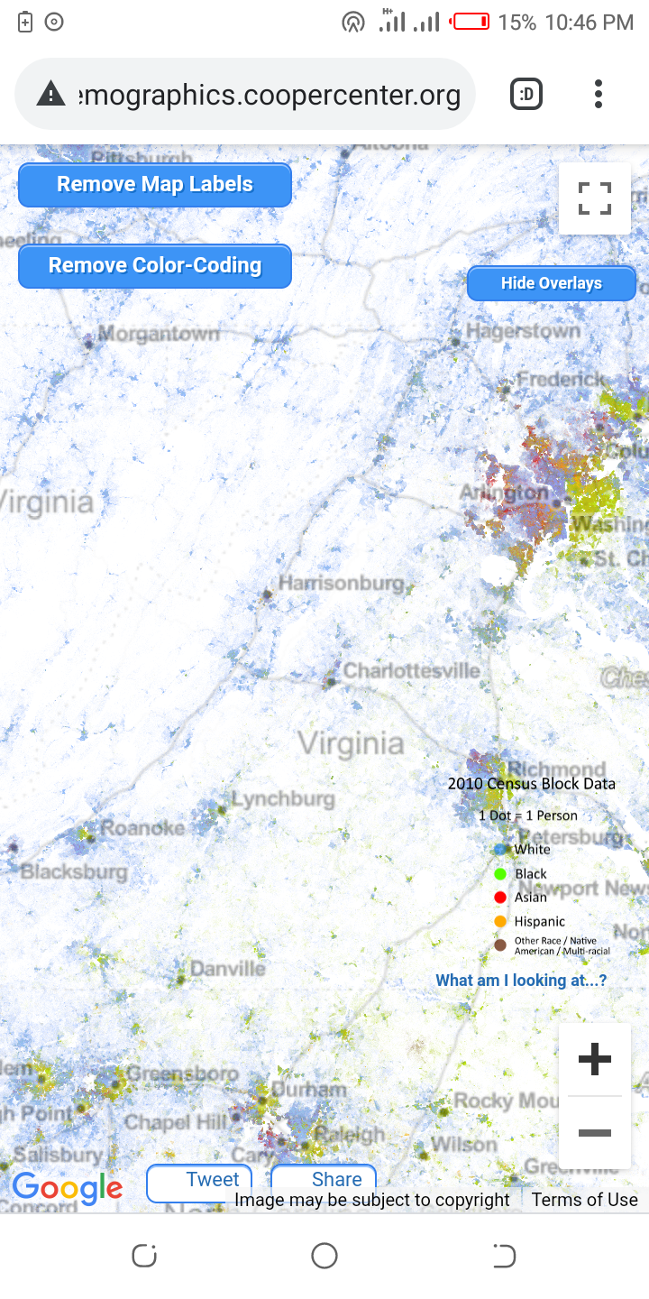
New York
Its ethnically diverse metropolis.
It is the most populated city.
Land 302.64 square miles.
27012.5 persons per square mile.
Population of 8336817 people
Notes:
It is the most populated city with a population density of 27012.5 persons per squire mile.
It has a population of 8336817 people

Slide 5
Conclusion
New York city is the most populated city.
Most states are ethnically diverse metropolis.
Population density is average among the states except in cities.
Notes:
Cities have high population density than other states. besides, most of them are ethnically diverse.

